Slide 1
HERITAGE SUNDAY MAY 24, 2019
BRIEF HISTORY OF THE UNITED METHODIST CHURCH

Slide 2
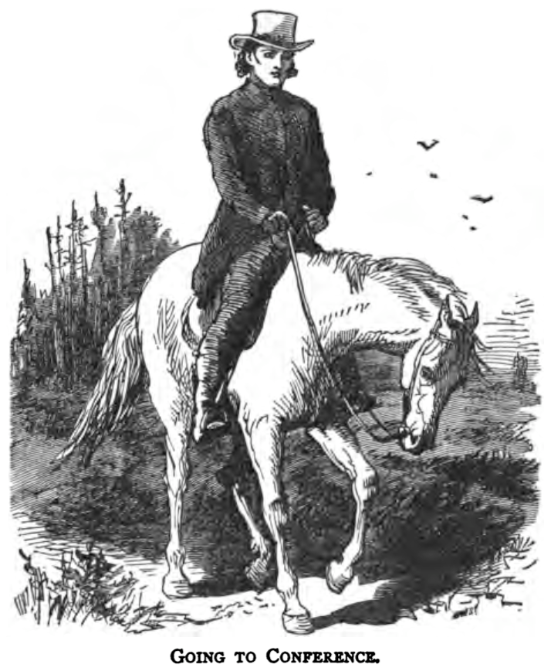

Slide 3
In 1620, the pilgrims began to come to America for religious freedom. They set the tone for the religious foundation for our country. The colonies began to populate and in March 1736, John and Charles Wesley arrived in America to be missionaries from England. This was their only visit to America. They returned home to England disappointed and disillusioned after being largely unsuccessful as missionaries. Charles left in December 1736 and John left in February 1738.

Slide 4
The Wesley brothers had a religious experience that changed their lives in May of 1738. In the following years they led a revival in the Church of England. The Methodist Church grew and soon Methodist began to travel to the colonies. The Methodist Church in America soon began as started by lay leaders and not pastors. An immigrant farmer named Robert Strawbridge organized the church in Maryland and Virginia as early as 1760.

Slide 5
To strengthen the Methodist Church in America, John Wesley sent two lay pastors to America in 1769. Two years later, Frances Asbury came to America to assist with the growth of the church. He became an instrumental figure in the early American Methodist Church. The first conference of Methodist preachers in the colonies was held in Philadelphia in 1773. Ten pastors attended.

Slide 6
With so few pastors and so many churches spread out among the colonies and surrounding areas, you can imagine that this was a problem for the new church. From this dilemma came the concept of the “Circuit Riders”. The circuit rider was responsible for the religious welfare of the scattered Methodist Church. He often traveled as many as 40-50 miles between churches. They endured incredible hardships, traveling through all sorts of weather and dangerous terrain. They often had to deal with disease, hostile natives and even highway men (robbers). Most circuit riders did not live to see 30 years of age.

Slide 7
The circuit riders carried few worldly possessions in their saddle bags. This included their Bibles, songbooks, change of clothing and food. When they did arrive at their locations, the churches were often log cabins, barns, schools, outdoor camp grounds and maybe a house. Very few churches had church buildings to meet in. Francis Asbury, the founding Bishop of American Methodism traveled around 270,000 miles and preached 16,000 sermons as he traveled his circuits. These were brave pastors who knew and understood the sacrifices that would be necessary to grow the Methodist Church in America.

Slide 8
The American Revolution had a profound impact on the Methodist Church. After the war, the Methodist Church lost many members due to their unpopular stance against the war. Change was necessary and ordained ministers were sent to America and the Methodist Church in America was allowed to become independent.

Slide 9
In 1817-1843, the second great awakening began in America. Through many camp meetings and revivals, many people were converted and churches popped up all over the new states. The circuit riders were dispatched to reach these new areas. The membership of the church increased dramatically during this time. The second half of the 1800s saw the rise of the Civil War. The Methodist Church was an ardent and vocal opponent of slavery. This caused a rift with the southern states in the church. Church membership in the south was down 2/3 and many church buildings lay in ruins.

Slide 10
The reconstruction era was from 1866-1913. In 1914-1918, America participated in World War I. This was also a difficult time for the Methodist Church since they traditionally did not support war, instead advocating for negotiation. In 1939-1945, America found itself in another world war. Again, the church took the stance of negotiation instead of war. These were difficult times for the country and for the Methodist Church.

Slide 11
In 1968, the United Methodist Church was formed when the United Brethren Church and the Evangelical Church joined with the Methodist Church. Also in 1968, the UMC insignia was first used.
In 1956 full clergy rights for women were finally granted in the new church. When the United Methodist Church was formed it had approximately 11 million members world wide. This makes the United Methodist Church one of the largest protestant churches in the world.

